Slide 1

Group Discussion
This Photo by Unknown author is licensed under CC BY-SA-NC.

Slide 2

The Mysteries of the Human Mind and Consciousness
Grp members:
Sai Ganesh Eswaraprasad
Eshwar Deshmukh Chavan
Karthikeya Sai
Abhivardhan
Dhanvardhan

Slide 3

How and why we chose the particular topic ?

Slide 4

Topic Selection
We team members have actively participated and thought of the topic because of its mysteriousness and the failure of its proper understanding. It is related to the knowledge of the core representation of who we are and consists of many topics up for debate

Slide 5

What is consciousness?

Slide 6

What is consciousness
• Consciousness is the awareness of one's thoughts, feelings, sensations, and surroundings.
• It is considered a complex and mysterious phenomenon.
• It is often considered the defining characteristic of humans and other animals.
• There are many theories about consciousness, but none have been definitively proven.
• Some theories suggest consciousness arises from brain activity or information processing.
• The exact nature of consciousness and how it arises from brain activity is still unknown and a subject of ongoing research.

Slide 7

Several theories have been proposed to explain consciousness:

Slide 8

Here are some key points for several theories about the workings of consciousness:
1. Neural activity theory:
• Consciousness arises from the activity of neurons in the brain.
• Specific regions of the cortex are thought to play a role in creating conscious experience.
2. Information processing theory:
• Consciousness arises from the way information is processed and represented in the brain.
• The focus is on the relationship between information processing and conscious experience.
3. Global workspace theory:
• Consciousness arises from the distribution and integration of information across different regions of the brain.
• Conscious experience is thought to be created by the way information is shared and integrated in the brain.
4. Integrated information theory:
• Consciousness arises from the integration and combination of information in the brain.
• Conscious experience is thought to be created by the way information is combined to form a unified experience.

Slide 9
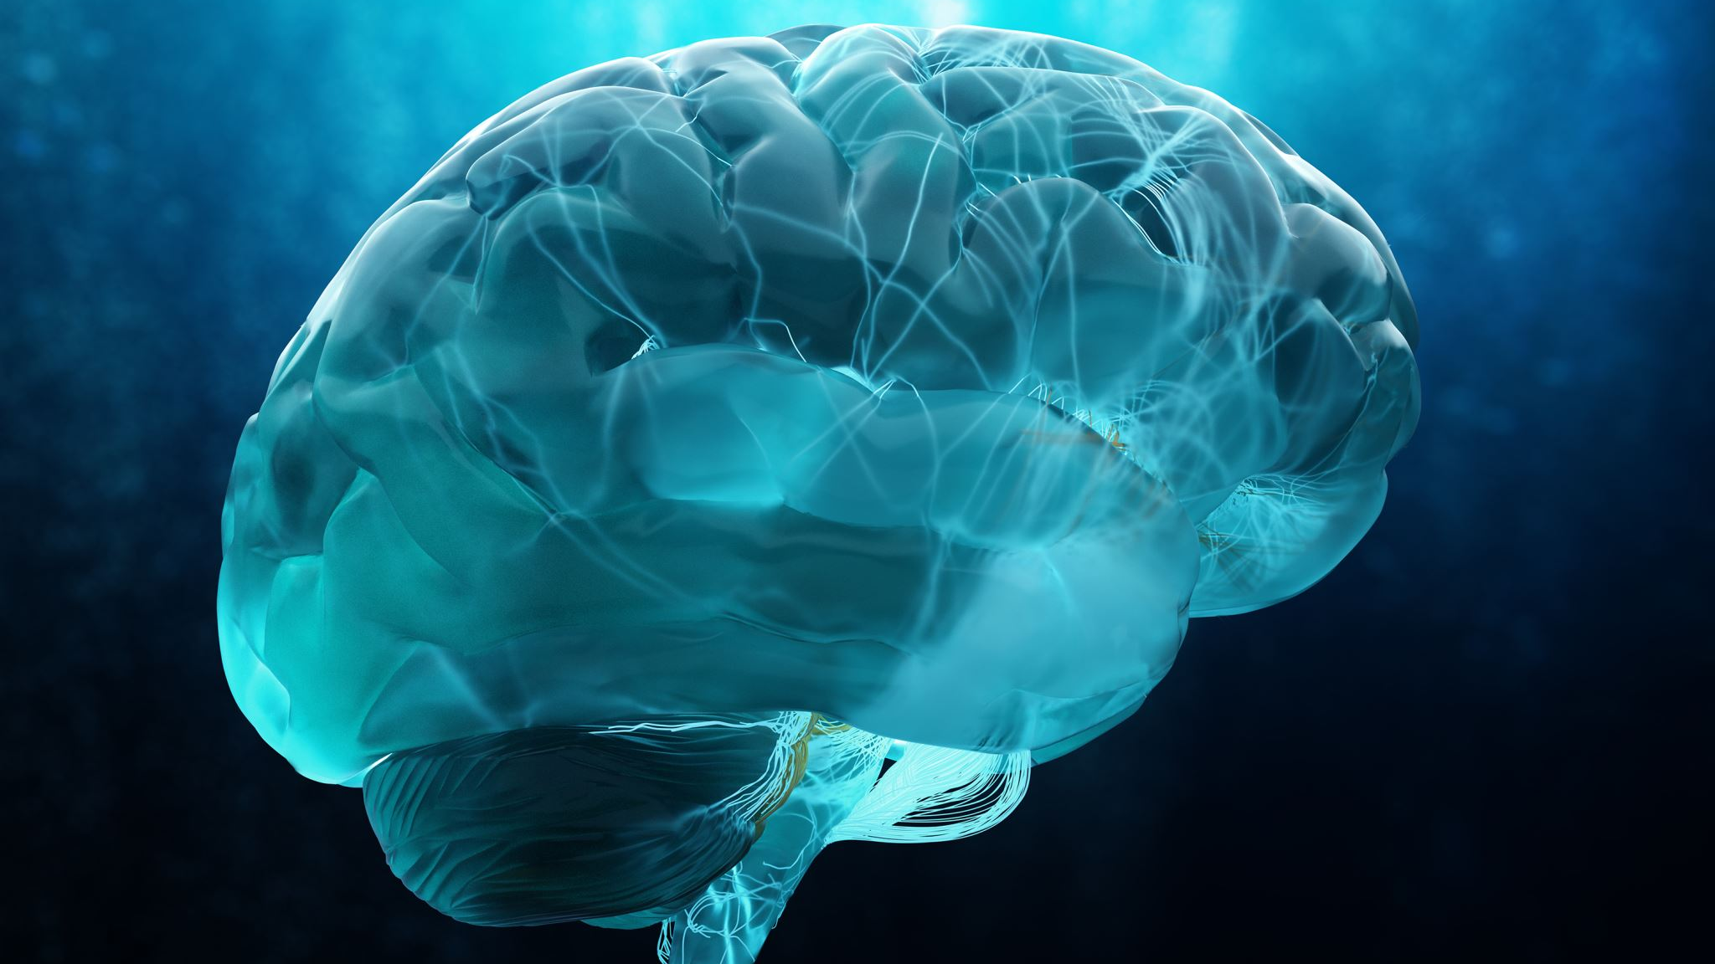
These are just a few of the many theories about the workings of consciousness, and each has its own strengths and weaknesses. Despite ongoing research, the exact nature of consciousness and how it arises from brain activity remains one of the biggest mysteries in science and philosophy.

Slide 10

The mysteries of the human mind

Slide 11
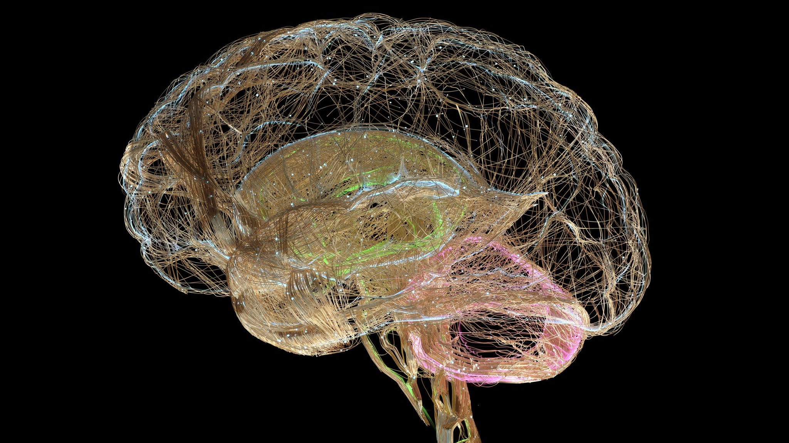
The human mind is a complex and still largely mysterious entity that encompasses the brain, thoughts, emotions, consciousness, and behavior. Despite advances in neuroscience and psychology, much is still unknown about the workings of the human mind.

Slide 12

Some of the mysteries of the human mind include:
1. Consciousness: How does the brain create subjective conscious experience?
2. Memory: How is information stored and retrieved in the brain?
3. Emotions: How do emotions arise from brain activity and how do they influence behavior?
4. Perception: How does the brain process sensory information to create our perception of the world?
5. Free will: To what extent are our actions determined by our biology and environment, and to what extent do we have control over our choices?
6. Imagination: How does the brain generate mental images and simulations of experiences that have not actually occurred?

Slide 13

These are just a few of the many mysteries of the human mind that are the subject of ongoing research and investigation by scientists and philosophers. Despite many advances, much is still unknown about the human mind, and it remains one of the greatest mysteries in science.

Slide 14

Disagreements
Our team members agreed and disagreed on several topics and opinions on the power and replaceability of artificial intelligence

Slide 15
The Human Mind vs AI
Creativity: Humans have the ability to create new and original ideas, whereas AI systems can only generate outputs based on pre-existing data.
Emotion and empathy: Humans have the ability to experience a range of emotions and to understand and respond to the emotions of others, whereas AI systems lack emotional intelligence.
Flexibility and adaptability: Humans have the ability to adapt to new situations and solve problems in creative ways, whereas AI systems are limited by their programming and can only solve problems within their pre-defined parameters.
Conscious experience: Humans have subjective conscious experiences, such as feelings and self-awareness, which are not yet replicated in AI systems.
These differences demonstrate that while AI systems can perform specific tasks more efficiently than humans, they lack the broader range of abilities and experiences that make the human mind unique.

Slide 16

Advantages and disadvantages of understanding the mysteries of the human mind and consciousness:

Slide 17
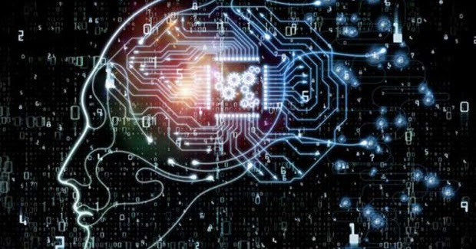
Advantages
Improved mental health treatments: A better understanding of consciousness could lead to more effective treatments for mental health disorders, such as depression and anxiety.
Advancements in artificial intelligence: A deeper understanding of consciousness could lead to the development of more advanced artificial intelligence systems.
Enhanced quality of life: A better understanding of consciousness could lead to improvements in various aspects of life, such as sleep, creativity, and overall well-being.
This Photo by Unknown author is licensed under CC BY.

Slide 18

Disadvantages
1. Ethical concerns: As our understanding of consciousness improves, ethical concerns may arise, such as the potential misuse of this knowledge for malicious purposes.
2. Reductionist view: A focus on understanding consciousness in terms of brain activity and neural processes may lead to a reductionist view that neglects the subjective, personal experience of consciousness.
3. Lack of consensus: Despite ongoing research, there is still a lack of consensus among scientists and philosophers on the nature of consciousness and how it arises from brain activity. This lack of consensus may hinder progress in this field.

Slide 19

Overall, the study of the mysteries of the human mind and consciousness has the potential to bring about many benefits, but also raises important ethical and philosophical questions that need to be considered.

